Slide 1
Predicting Volatility
Volatility Machine Learning Model
Lucas Bernal, Will Zimmer, Aryan Bonigala

Slide 2
Agenda
SESSION
Introduction/Motivation
Data Description
Methodology
Results & Analysis
Conclusion & Future Work

Slide 3
Introduction + Motivation
1
"Volatility is the price of admission. The prize inside are superior long-term returns. You have to pay the price to get the returns.“ -Morgan Housel
What did we do?
SPY Returns
Created Machine Learning model to predict volatility
Recent market volatility has driven large gains/losses
Wanted to create a model to predict future volatility
Inform investment decisions based on model outputs

Slide 4
Hypothesis
Research Question
Hypothesis
Can a machine learning model accurately predict future SPY (S&P 500 ETF) market volatility using historical price, volume, and technical indicators?
A machine learning model (e.g., Random Forest Classifier) can effectively forecast high or low volatility periods.
Features like returns, rolling volatility, ATR, skewness, kurtosis, and Bollinger Bands enable accurate predictions.
Model outputs can inform investment and risk management decisions.

Slide 5
Model Workflow
Raw Data
Feature Engineering
Model Training
Model Deployment
Model Evaluation
Notes:
First is the raw data gathered from yahoo finance. Has the open, close, high, low price and trading volume
Cleaning the data to remove any errors and missing values. We also split our data 80/20
Next is feature engineering where we took this processed data and turned it into something the model can use. We created features to capture different ascots of market behavior
Then we move on to model training. Give the data to the Random Forest Classifier which learned to classify periods as high or low volatility based on the threshold we set

Slide 6
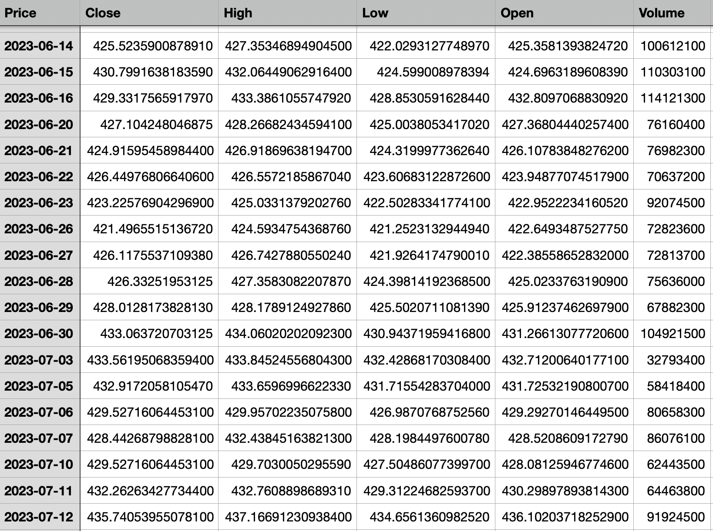
Data Description
Notes:
This is a sample of our rawdataset from June 2023. It includes the open, close, high, low and volume for the SPY.
Our total data covers 5 year from Jan 1st 2019 to Jan 1st 2024
Before we use this dataset we have to clean it up so that it’s ready for the next step feature engineering.

Slide 7
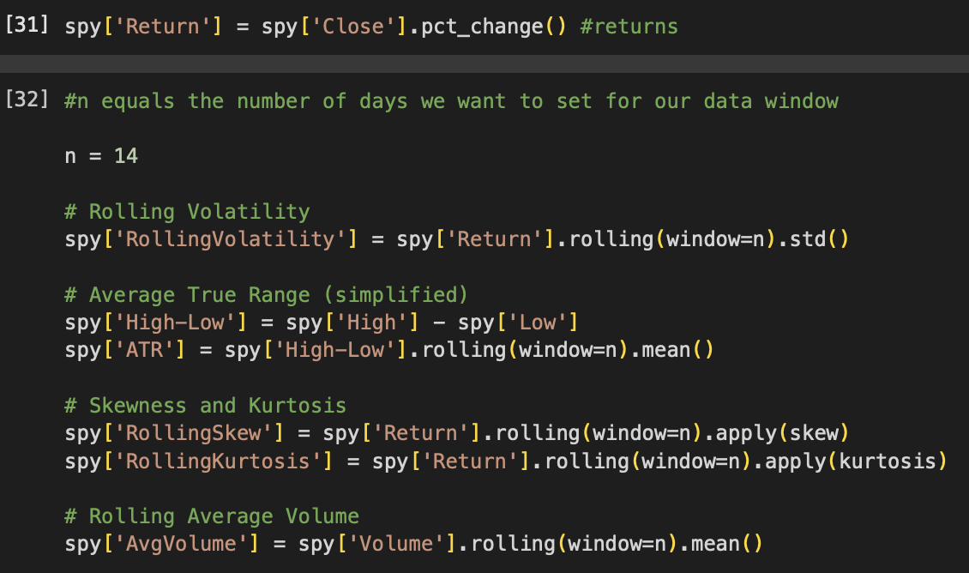
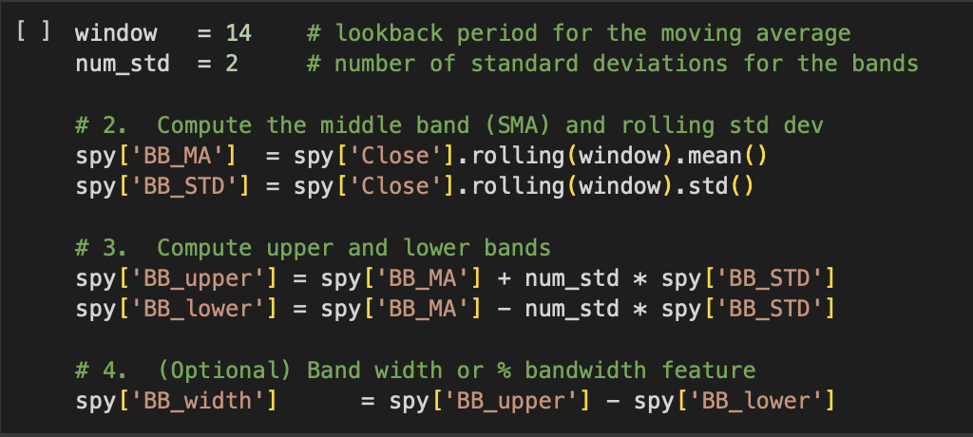

Feature Engineering
Notes:
Calculated returns which is just the percentage change in the closing price from one day to the next.
Rolling Volatility. A 14 day window and calculated the standard deviation of return which shows how much prices were swinging over that period
ART. Difference between the high and low price over 14 days. Gives us a sense of the typical price range
Skewness. Skewness tells us if returns are leaning more positive or negative
Kurtosis shows if there are extreme price moves like big spikes
Rolling average volume. Average trading volume over 14 days. Reflects the how active the market was.
Bollinger Bands. 14 day simple moving average and two standard deviation to form upper and lower bands. Help to spot when prices are unusually high or low

Slide 8
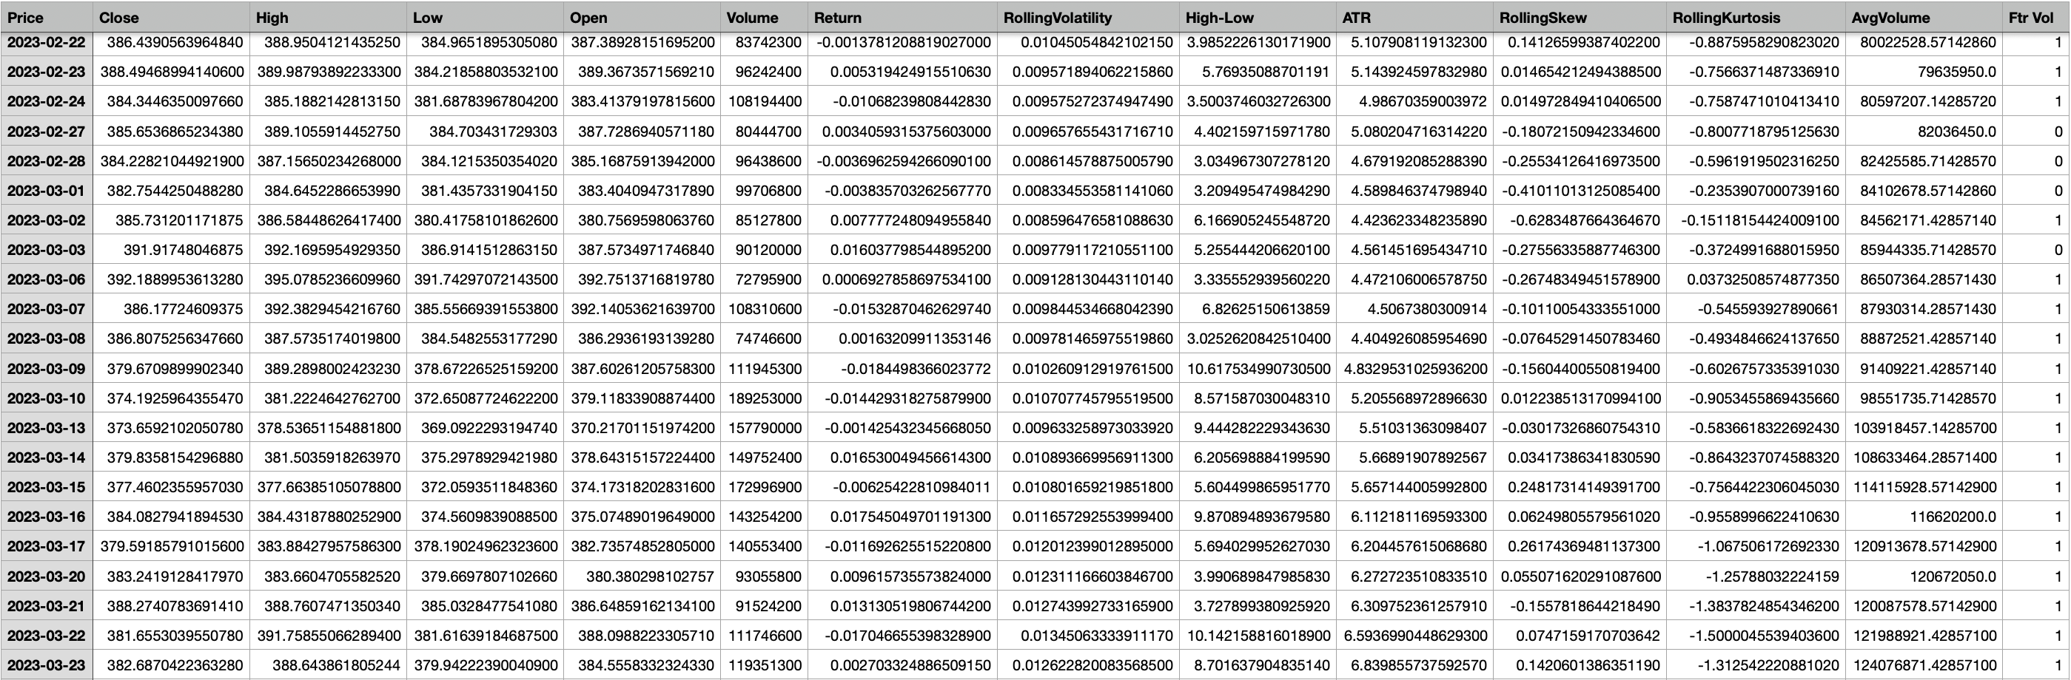
Feature Engineering
For the target value “Ftr Vol” (Future Volatility) , 1 = High Volatility and 0 = Low Volatility
Notes:
Data after feature engineering.
It gives use the rolling volatility, ATR, Skewness, kurtosis, and Average volume
By combining all of these price based features, statistical measure and volume data we made sure the model had everything it needed to predict volatility accurately
Defined market regimes: High Volatility (1) if next week’s rolling volatility exceeds historical median; Low Volatility (0) otherwise.

Slide 9
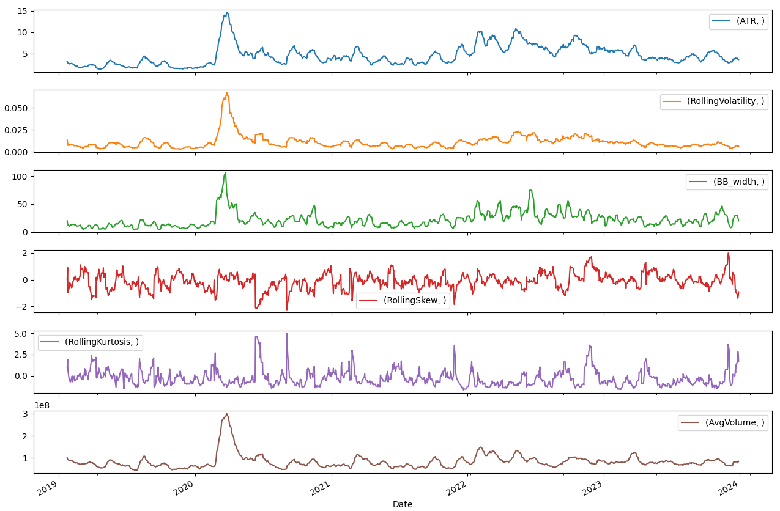
Data Visualization
Notes:
These are graphs of all the features that we used over a 5 year time period.
This graph help confirm that our features made sense and were ready for modeling

Slide 10
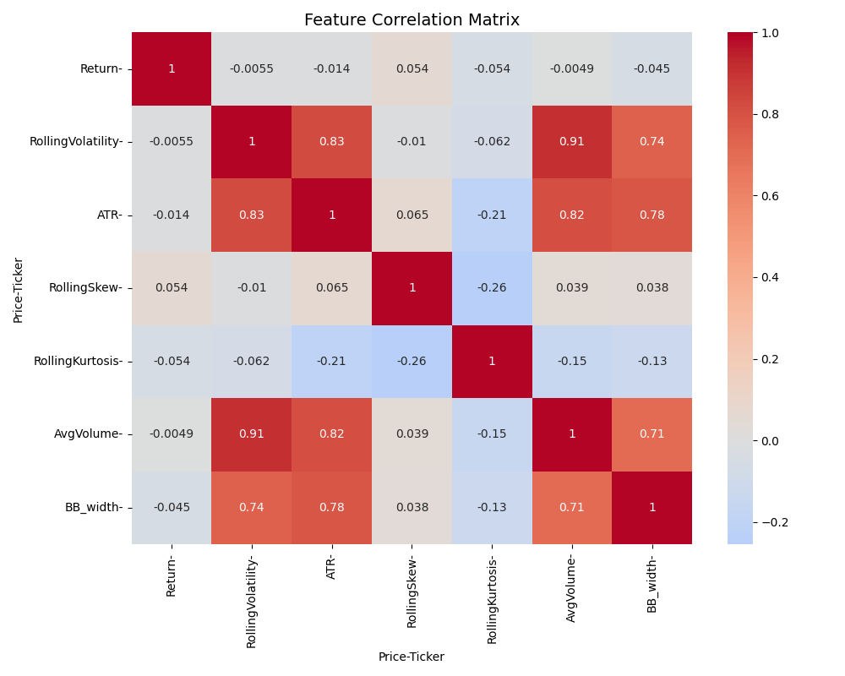
Data Visualization
1 = Strong Positive Relationship
0 = No Relationship
-1 = Strong Negative Relationship
Notes:
Feature correlation matrix shows how our engineered feature relate to each other
-1 for strong negative relationship to 1 for a strong positive one
Rolling Volatility and ATR have a moderate positive correlation, around 0.054. This makes sense because both measure how much prices are moving.
Returns and Bollinger Band Width show a slight negative correlation, about -0.045. This suggests that when prices swing a lot, the bands tend to widen, which is what we’d expect.
Skewness and Volume have a very low correlation, around -0.01, which is great—it means they’re providing unique information to the model.
The lower the correlation with each other told use our feature engineering was on the right track creating a divers set of inputs
Now I will hand it over to Lucas to show you how this is important in getting our data ready for model training

Slide 11
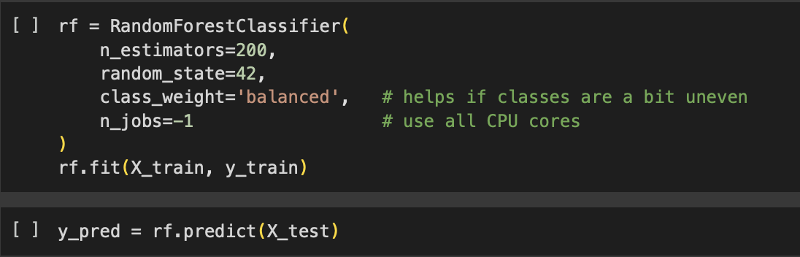
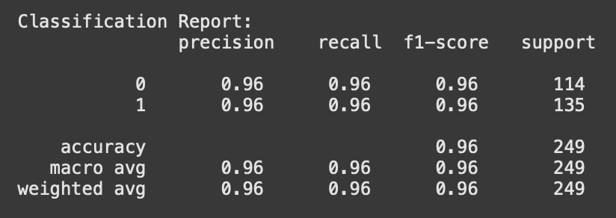
Model Training
OVERFITTING

Slide 12
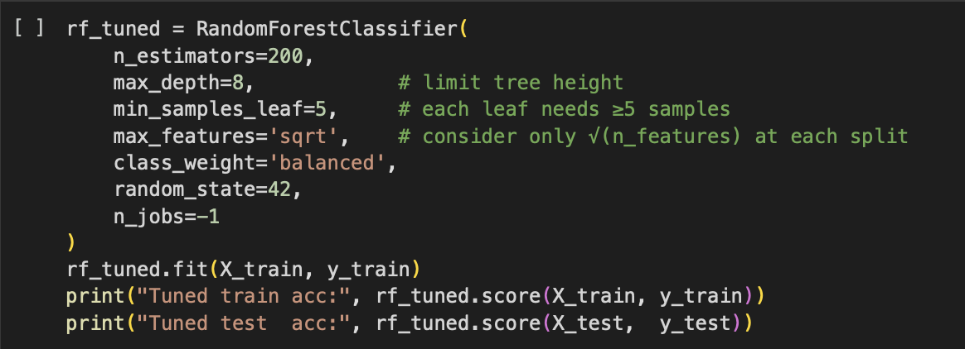
Combatting Overfitting

Slide 13
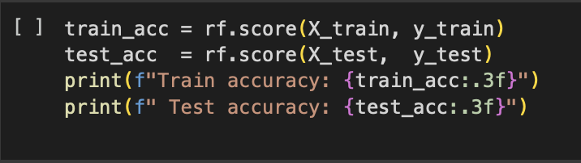
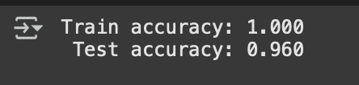
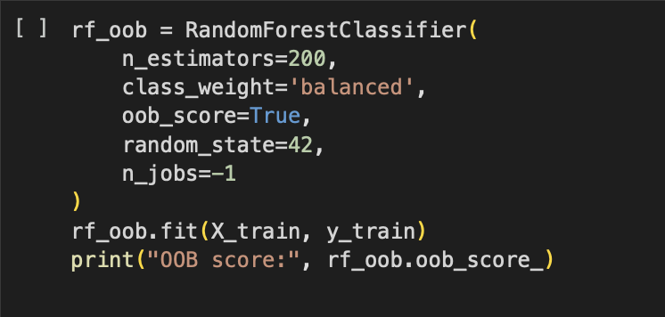

Combatting Overfitting
NOT
OVERFITTING
If train accuracy ≈ test accuracy, the model isn’t overfitting.
If the OOB score ≈ test accuracy, the model isn’t overfitting.
Notes:
OOB Score = Out of bag score, uses samples not used in the model training to try and make the model unbiased. If its much lower than the other accuracy, overfitting.

Slide 14
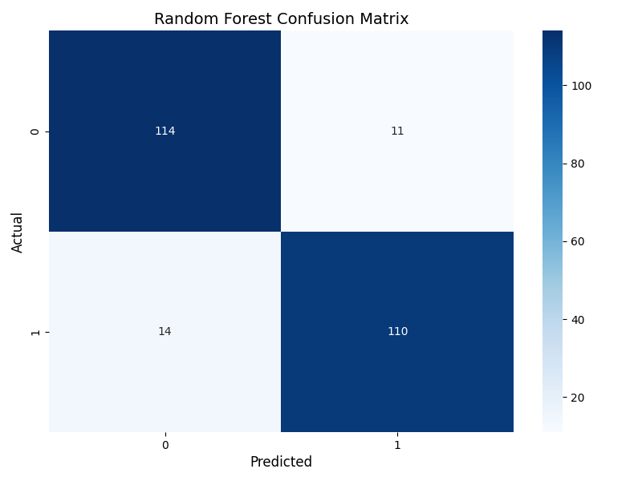
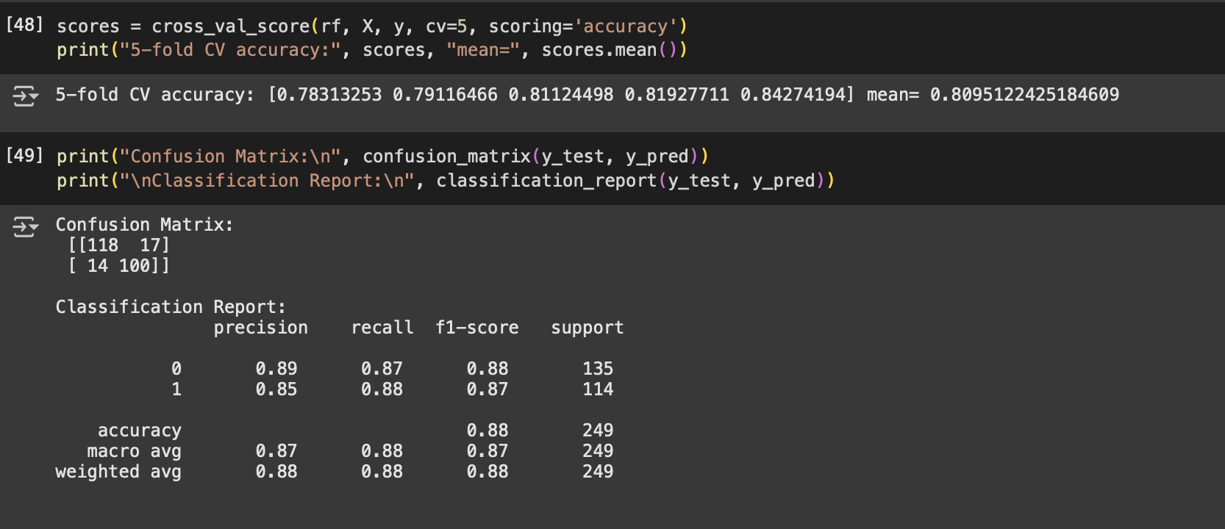
Results
Notes:
Support: number of actual volatility values
F1 score: harmonic mean of precision and accuracy
Accuracy: proportion of all classifications, high or low vol, that were correct
Precision: IE: how many predicted high vol days actually were high vol. = Predicted high vol / correct high vol predictions
Recall: IE: how many high volatility days were predicted correctly. = Total high vol / predicted high vol

Slide 15
Conclusion
Project Summary
Our model was able to predict future market volatility using a comprehensive set of features derived from options prices and market data
The model demonstrated promising predictive accuracy, with minimal signs of overfitting as evidenced by similar train and test scores,
Our results suggest that machine learning approaches can effectively capture patterns in volatility, supporting their use as decision tools for risk management and investment strategies

Slide 16
Future Work
Future Work
Incorporate additional data sources, such as macroeconomic indicators or alternative data (e.g., news sentiment), to further improve model
Implement real-time model retraining and adaptive learning to respond to changing market conditions and regime shifts
Backtest and deploy the model in a live trading environment to evaluate its real-world performance and refine trading strategies based on model outputs
Investigate the interpretability of the model to better understand which features drive predictions, enhancing transparency for end-uses

